Slide 1
Microsoft Power BI

Slide 2
Design Patterns and Best Practices with Power BI Embedding
Ted Pattison
Principal Program Manager
Power BI Customer Advisory Team (PBICAT)

Slide 3
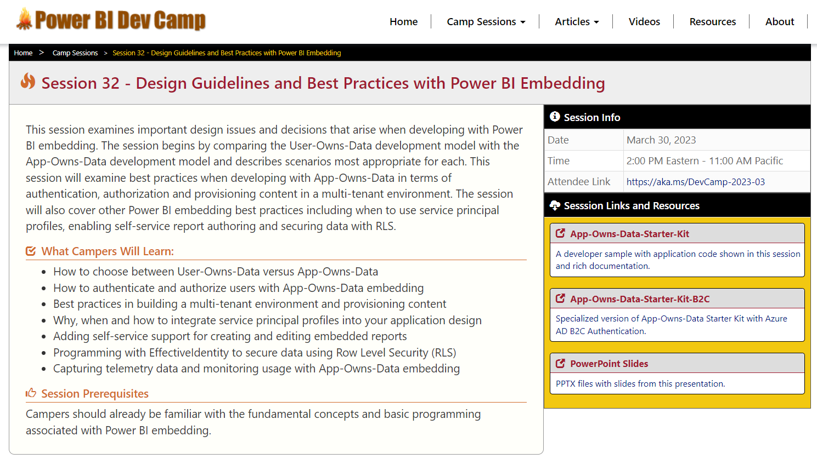
Welcome to Power BI Dev Camp
Check out the Power BI Dev Camp Portal at https://powerbidevcamp.net

Slide 4
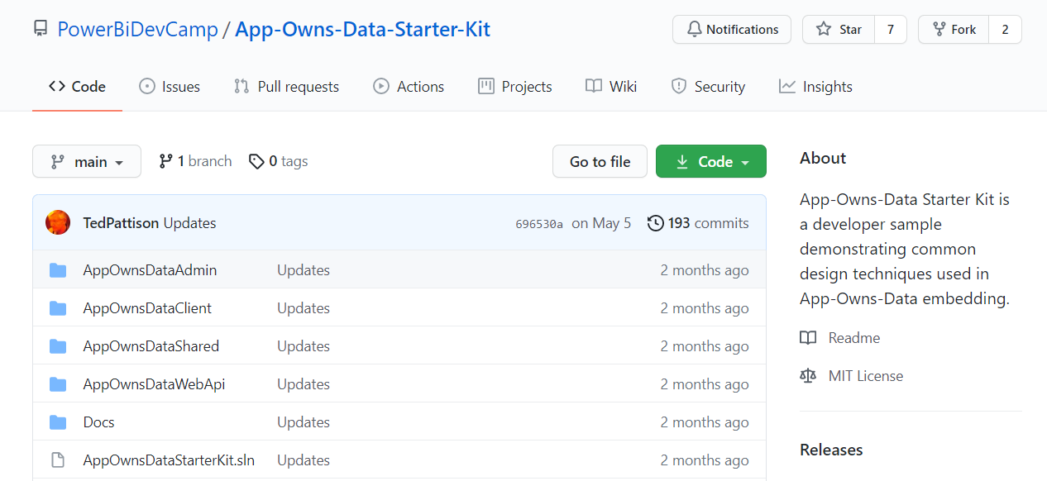
GitHub Repository with App-Owns-Data Starter Kit
All source code and documentation available through public GitHub repository
https://github.com/PowerBiDevCamp/App-Owns-Data-Starter-Kit
There is a second repository with a version specialized to use Azure AD B2C
https://github.com/PowerBiDevCamp/App-Owns-Data-Starter-Kit-B2C

Slide 5
Agenda
User-Owns-Data versus App-Owns-Data
Authenticating Users with App-Owns-Data
Multi-tenant Provisioning Patterns
Service Principals and Service Principal Profiles
Permissions Management with App-Owns-Data
Self-service report authoring
Token Management
Effective Identity and RLS
Monitor user activity

Slide 6
Power BI Embedding – The Big Picture
Sequence of events that occur when embedding a report
User launches your app using a browser
App authenticates with Azure Active Directory and obtains access token
App uses access token to call to Power BI Service API
App retrieves data for embedded resource and passes it to browser.
Client-side code uses Power BI JavaScript API to create embedded resource
Embedded resource session created between browser and Power BI service
5
Power BI Service
Browser
iFrame
6
4
4
3
1
Your App
2
Azure AD

Slide 7
Choosing the Correct Embedding Model
User-Owns-Data Embedding (SaaS)
aka Embed for your customers
App-Owns-Data Embedding (PaaS)
aka Embed for your customers
User-Owns-Data Embedding for use within Organization
App-Owns-Data Embedding for use by ISVs
Browser
Power BI Service
Browser
Power BI Service
iFrame
iFrame
Azure AD
Access Token
Power BI
Embed Token

Slide 8
User-Owns-Data vs App-Owns-Data Comparison
 | User-Owns-Data | App-Owns-Data
Also Known As (AKA) | Embed for your organization | Embed for your customers
Development Model | Software as a Service (SaaS) | Platform as a Service (PaaS)
Commonly used by | Enterprise organizations | Independent Software Vendors (ISVs)
Used for multi-tenant applications | NO | YES
Identity Provider | Azure AD | Developer is free to choose
User Account Type | Azure AD Work and School account | Any
Permissions | Permissions managed by Power BI Service | Permissions managed by application developer
Prevent user going to Power BI portal | NO | YES
Power BI REST API | Calls executed under identity of current user | Calls executed under identity of service principal
Security token | Azure AD access token | Embed token
Can be deployed as SPA | Yes | No, service principal requires server-side code
Requires dedicated capacity | It Depends | YES
Supported SKUs | Power BI Pro Power BI Free with Power BI Premium (P) Power BI Free with Power BI Premium (EM) | Power BI Embedded (A) Power BI Premium (P) Power BI Premium (EM)

Slide 9

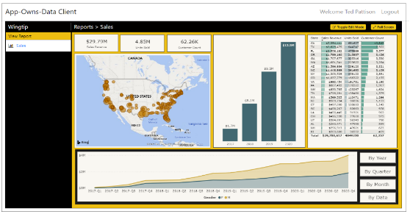
Customer Tenants in App-Owns-Data Embedding
Tenant represents a customer with one or more users
You must create a separate tenant footprint in Power BI for each customer
Don’t confuse this use of term “tenant” with an Azure AD tenant – they are completely different
Power BI environment
Customer 01
17 users
Customer 01 Tenant
Sales
Power BI Workspace
Power BI Dataset
Datasource credentials
Power BI Report

Slide 10
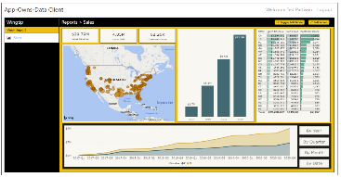
Designing a Multi-tenant Environment
Power BI Multi-tenant Environment
Customer 01
17 users
Customer 01 Tenant
Sales
Power BI Workspace
Power BI Dataset
Datasource credentials
Power BI Report
Customer 02
243 users
Customer 02 Tenant
Sales
Power BI Workspace
Power BI Dataset
Datasource credentials
Power BI Report
Customer N
74 users
Customer N Tenant
Sales
Power BI Workspace
Power BI Dataset
Datasource credentials
Power BI Report

Slide 11
App-Owns-Data Starter Kit - Value Proposition
Provides guidance for the following tasks and procedures
Onboarding new customer tenants
Managing user permissions
Implementing customer-facing client as Single Page Application (SPA)
Creating custom telemetry layer to log user activity
Monitoring user actions such as viewing, editing, and creating reports
Monitoring report performance across all customer tenants

Slide 12
App-Owns-Data Starter Kit Architecture
AppOwnsDataDB: custom database to track tenants, user permissions and user activity
AppOwnsDataAdmin: administrative app to create tenants and manage user permissions
AppOwnsDataWebApi: custom Web API used by client-side SPA applications
AppOwnsDataClient: customer-facing SPA used to view and author reports (JavaScript & JQuery)
AppOwnsDataReactClient : customer-facing SPA used to view and author reports (modern React-JS)
AppOwnsDataAdmin
AppOwnsDataDB
Power BI REST API
AppOwnsDataClient
AppOwnsDataWebApi
AppOwnsDataReactClient

Slide 13
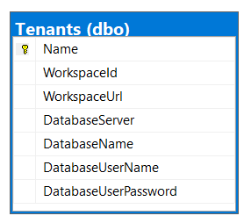
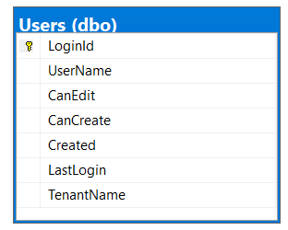
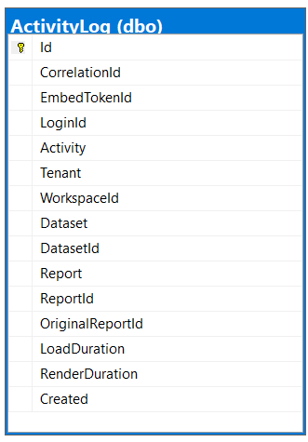
Database Schema for AppOwnsDataDB
Tenants table tracks Power BI workspace Id and customer database connection info
Users table tracks user profile with tenant assignment and permissions within tenant
ActivityLog table tracks telemetry data about user activity and report performance

Slide 14
App-Owns-Data Starter Kit Videos
Session 11: Developing with the App-Owns-Data Starter Kit
https://www.powerbidevcamp.net/sessions/session11/
Session 25: Modern React-JS Development with Power BI Embedding
https://www.powerbidevcamp.net/sessions/session25/
Session 26: Modern React-JS Development with App-Owns-Data Embedding
https://www.powerbidevcamp.net/sessions/session26/
Session 27: Integrating Azure AD B2C with App-Owns-Data Embedding
https://www.powerbidevcamp.net/sessions/session27/

Slide 15
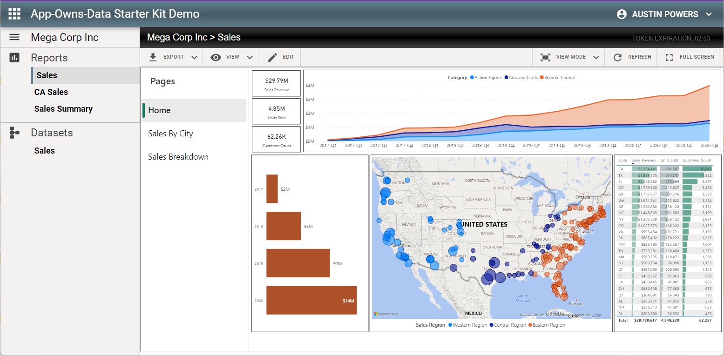
Try out the App-Owns-Data with Azure AD B2C Demo
Navigate to https://aka.ms/AppOwnsDataDemo
This demo authenticates users using Azure AD B2C
You can login using Work or School account or social media account with Facebook or LinkedIn

Slide 16
Agenda
User-Owns-Data versus App-Owns-Data
Authenticating Users with App-Owns-Data
Multi-tenant Provisioning Patterns
Service Principals and Service Principal Profiles
Permissions Management with App-Owns-Data
Self-service report authoring
Token Management
Effective Identity and RLS
Monitor user activity

Slide 17
Identity Providers and App-Owns-Data Development
App-Owns-Data development allows you to pick any identity provider
Identity provider responsible for authenticating user and validating LoginId
App-Owns-Data Starter Kit uses Azure AD as client app identity provider
Solution architecture designed to facilitate switching out the identity provider
AppOwnsDataClient
Azure AD
AppOwnsDataWebApi
AppOwnsDataClient
AAD B2C
AppOwnsDataWebApi
AppOwnsDataClient
OneLogin
AppOwnsDataWebApi
AppOwnsDataClient
PING
AppOwnsDataWebApi
AppOwnsDataClient
AppOwnsDataWebApi
AppOwnsDataClient
Auth0
AppOwnsDataWebApi
Okta

Slide 18
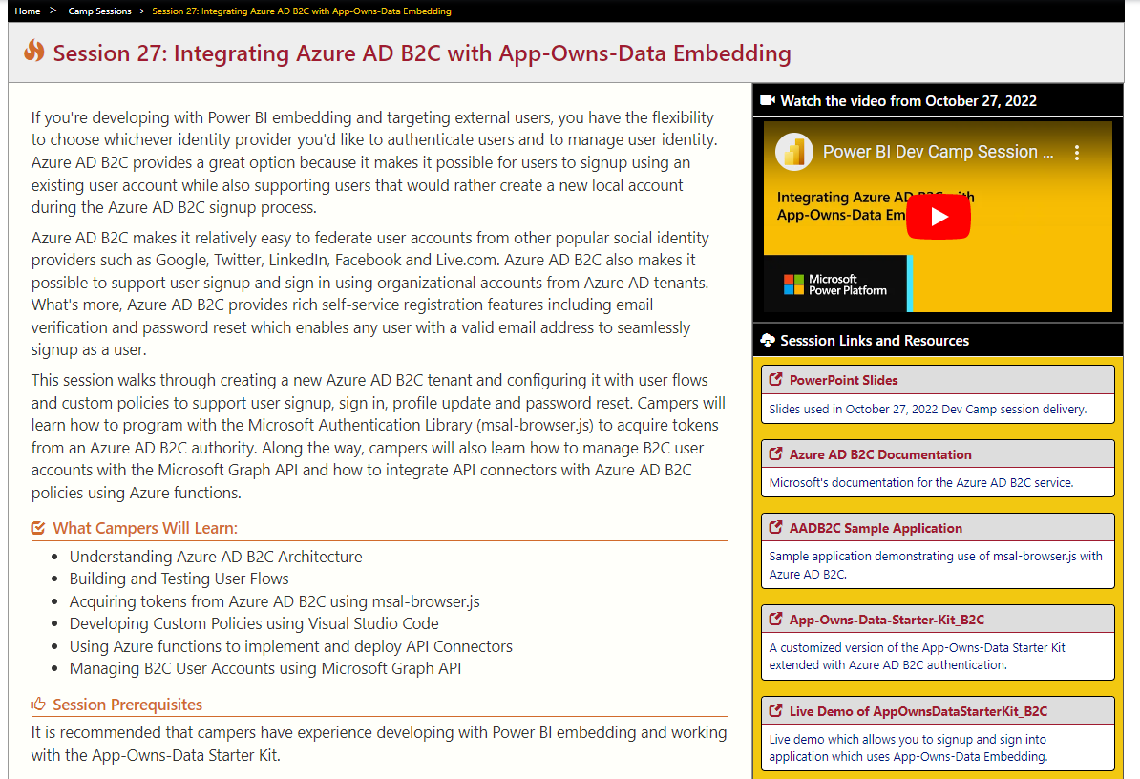
Integrating Azure AD B2C with App-Owns-Data Embedding
Session 27: Integrating Azure AD B2C with App-Owns-Data Embedding
https://www.powerbidevcamp.net/sessions/session27/

Slide 19
Agenda
User-Owns-Data versus App-Owns-Data
Authenticating Users with App-Owns-Data
Multi-tenant Provisioning Patterns
Service Principals and Service Principal Profiles
Permissions Management with App-Owns-Data
Self-service report authoring
Token Management
Effective Identity and RLS
Monitor user activity

Slide 20
AppOwnsDataAdmin
Uses Power BI REST API to provision workspaces for customer tenants
Calls to Power BI REST API as a service principal – not as a user
Adds a record to AppOwnsDataDB for each customer tenant
AppOwnsDataAdmin
Power BI REST API
Azure AD Service App
AppOwnsDataDB

Slide 21
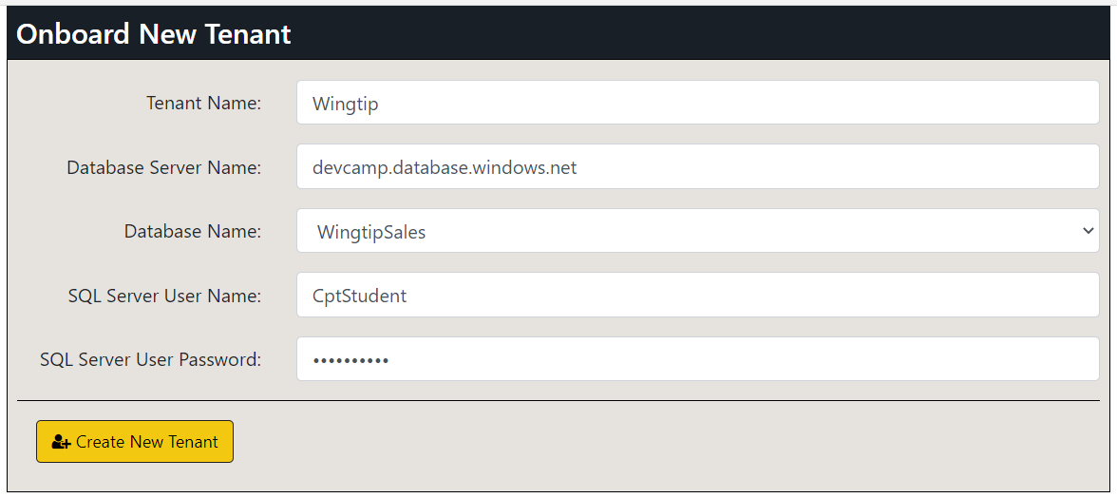
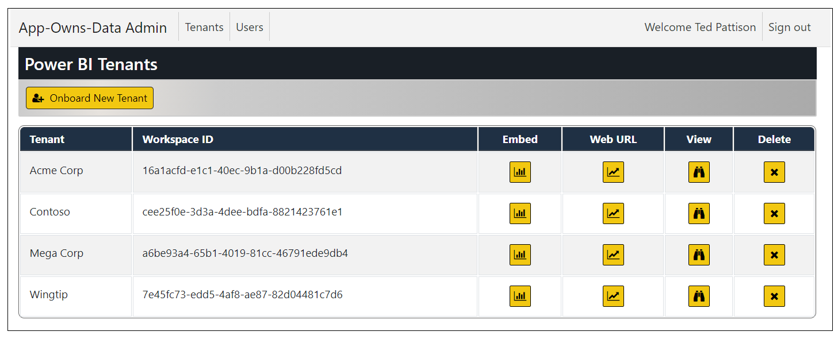
Provisioning Customer Tenants
AppOwnsDataAdmin provides Onboard New Tenant page
Behind the scenes, AppOwnsDataAdmin creates and configures Power BI workspace
Makes is possible to configure details for connection to customer database
Tenants can be viewed or deleted

Slide 22
Sequence of Tenant Provisioning Operations
Create a new Power BI workspace
Assign workspace to a dedicated capacity
Import template PBIX files to create datasets and reports
Update dataset parameters to redirect datasource to customer’s database
Patch datasource credentials
Start dataset refresh operations

Slide 23
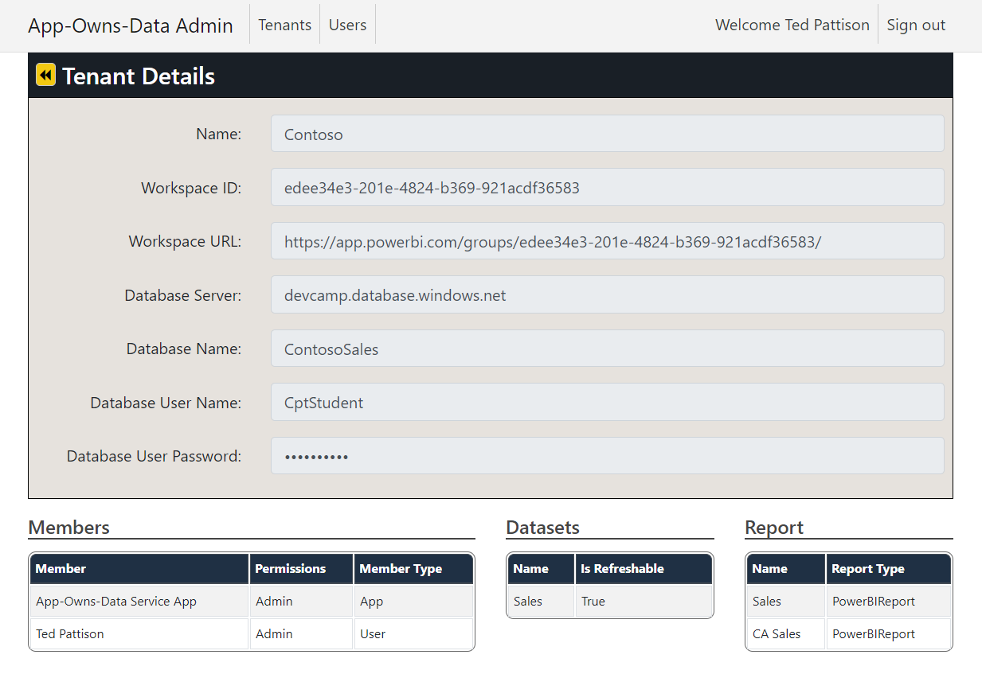
Tenant Details
Tenant Details page lists members, datasets and reports
AppOwnsDataAdmin calls Power BI REST API to discover workspace artifacts

Slide 24
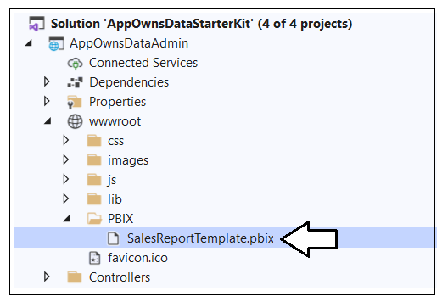
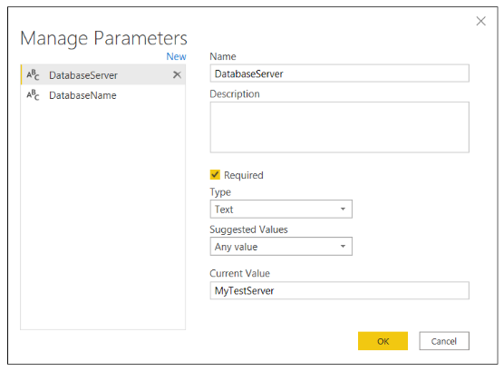
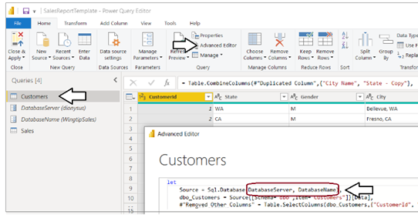
Understanding SalesReportTemplate.pbix
AppOwnsDataAdmin uses SalesReportTemplate.pbix as PBIX template file
PBIX import process creates Sales dataset and Sales report
Sales dataset parameterized with DatabaseServer and DatabaseName
Dataset parameters updated after import to redirect Sales dataset to customer database

Slide 25
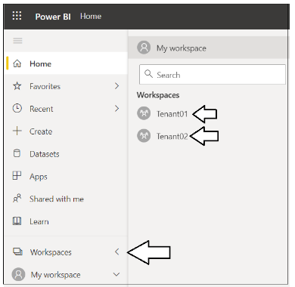
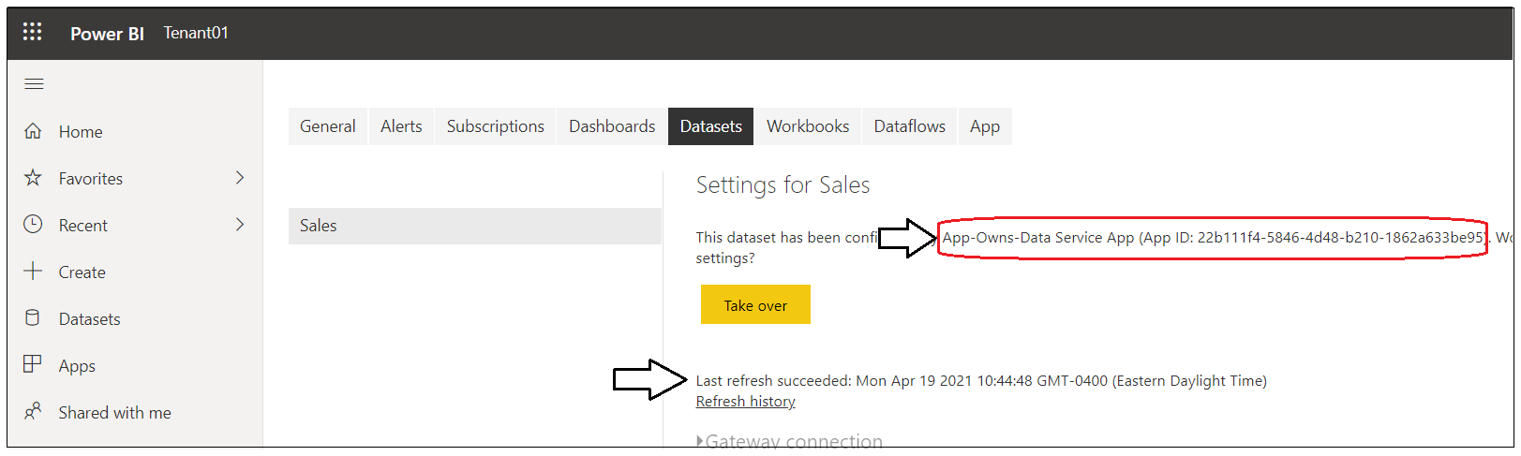
What’s been created in Power BI?
You can see the workspaces created in Power BI
There should be a Power BI workspace for each tenant that’s been created
ConfiguredBy property of Sales dataset should be set to App-Owns-Data Service App
Last refresh time should reflect refresh operation at end of onboarding process

Slide 26
Agenda
User-Owns-Data versus App-Owns-Data
Authenticating Users with App-Owns-Data
Multi-tenant Provisioning Patterns
Service Principals and Service Principal Profiles
Permissions Management with App-Owns-Data
Self-service report authoring
Token Management
Effective Identity and RLS
Monitor user activity

Slide 27
Understanding the 1000 Workspace Limitation
Adding service principal as member in over 1000 workspaces unsupported
Purpose of limitation is to maintain high levels of performance
Performance suffers as service principal is added to more workspaces
1000 workspace limitation is not enforced through code in Power BI Service
Observations about the 1000 workspace limitation
Adding service principal to 1000+ workspaces = unsupported scenario
Performance slows as the number of workspace memberships for SP increases
Being member of 100 workspaces will perform better than 1000 workspaces
Being member of 10 workspaces will perform better than 100 workspaces
Optimal number of workspace memberships for performance reasons = 1

Slide 28

Understanding Dataset & Datasource Credentials Isolation
Multitenant design should isolate customer tenants from one another
You don't want users seeing data from another tenant belonging to a different customer
Each dataset is owned by a single user or service principal
Dataset owner must set datasource credentials to connect to underlying datasource
Datasource credentials scoped by service principal and this scope extends across all workspaces
It's possible (but not recommended) to share dataset credentials across workspaces
Power BI Multi-tenant Environment
Customer 01 Tenant
Customer 01
17 users
Power BI Workspace
Power BI Report
Power BI Dataset
Azure SQL
Datasource Credentials
Sales
Customer 02 Tenant
Customer 02
118 users
Power BI Workspace
Power BI Report
Power BI Dataset

Slide 29

Understanding Service Principal Profiles
Service principal profiles are created as local accounts in Power BI Service
Service principal profiles created as alternative to separate service principal per customer tenant
New Profiles API allows service principal to create service principal profiles
No limit on how many service principal profiles can be created by a single service principal
Service principal profiles are unknowns to Azure AD and external datasources such as Azure SQL
Power BI Service
profile 1
Service
Principal
profile 2
profile 3

Slide 30
Service Principal Profiles and the Power BI Security Model
Service principal profile is first-class security principal in Power BI authorization system
Service principal profile can be added as workspace member
Service principal can execute Power BI REST API calls under identity of service principal profile
Service principal profile can create workspaces and datasets and set datasource credentials
Service principal profile can generate embed token for App-Owns-Data embedding
Multi-tenant Application
Workspace for Customer 1 Tenant
profile 1
Service
Principal
Workspace for Customer 2 Tenant
profile 2
profile 3
Workspace for Customer 3 Tenant

Slide 31

Service Principal Profile Per Customer Tenant
Can scale to any number of required tenants (e.g. 100,000+)
Each service principal profile owns datasource credentials for one customer tenant
Optimized performance due to profile being member of single workspace
Requires one-time creation of Azure AD application for service principal
Multi-tenant Environment Power BI Service
Customer 1
Multi-tenant Application
Workspace for Customer 1 Tenant
profile
Customer 2
Service
Principal
Workspace for Customer 2 Tenant
profile
Customer 3
profile
Workspace for Customer 3 Tenant
profile
Customer N
Workspace for Customer N Tenant

Slide 32
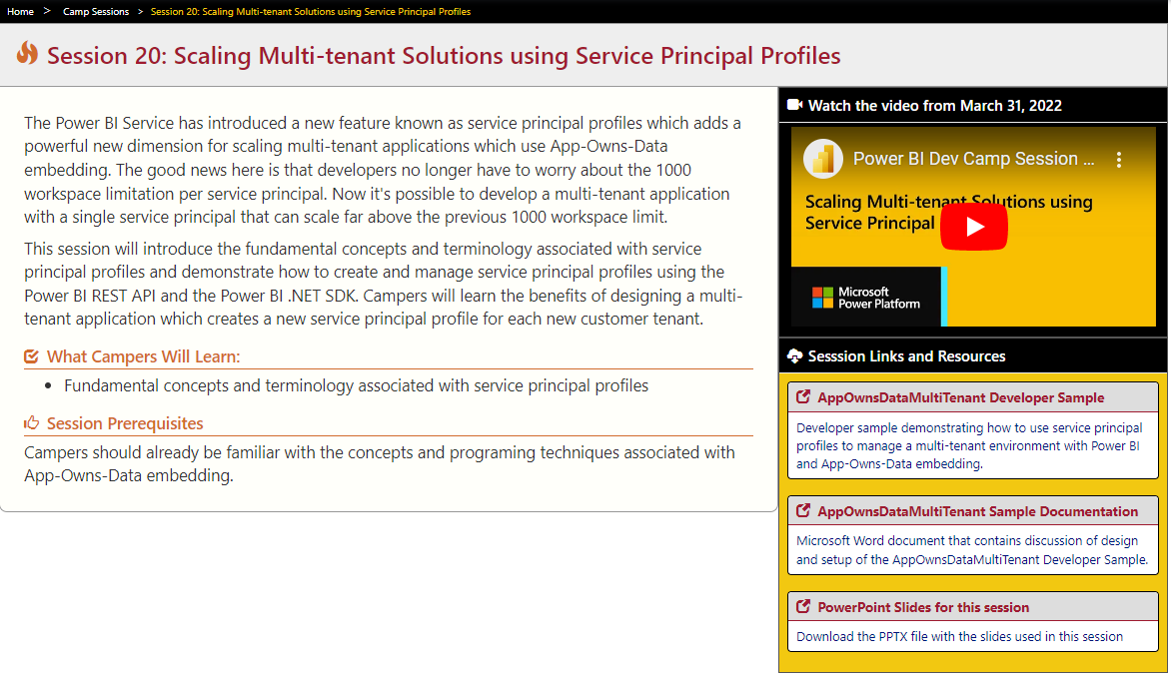
Scaling Multi-tenant Solutions using Service Principal Profiles
Session 20: Scaling Multi-tenant Solutions using Service Principal Profiles
https://www.powerbidevcamp.net/sessions/session20/

Slide 33
Agenda
User-Owns-Data versus App-Owns-Data
Authenticating Users with App-Owns-Data
Multi-tenant Provisioning Patterns
Service Principals and Service Principal Profiles
Permissions Management with App-Owns-Data
Self-service report authoring
Token Management
Effective Identity and RLS
Monitor user activity

Slide 34
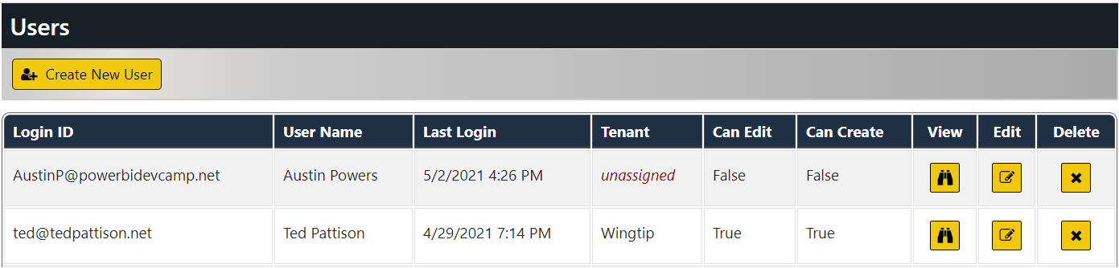
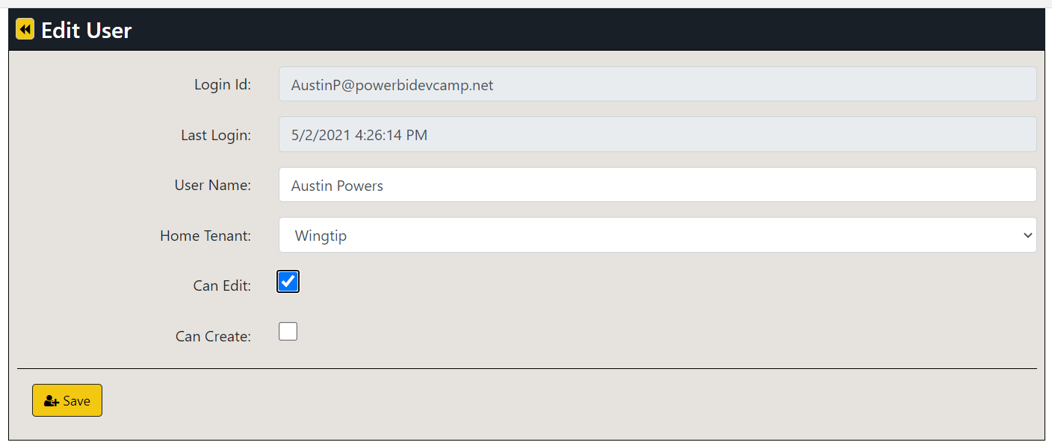
Managing User Permissions
Edit User page make it possible to assign user to a customer tenant
Users can optionally be assigned edit permissions and create permissions

Slide 35
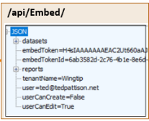
Embedding Data View Model
AppOwnsDataWebApi returns view model to AppOwnsDataClient
View model contains embedding data for reports and datasets
View model contains embed token used to embed reports
Embed tokens contains set of permissions generated for current user
AppOwnsDataReactClient
AppOwnsDataWebApi

Slide 36
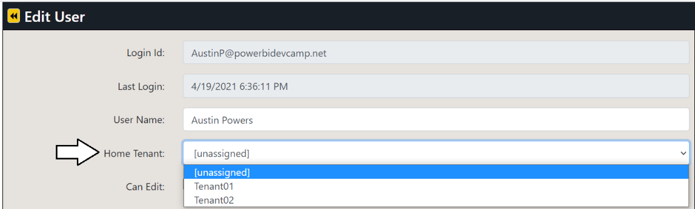
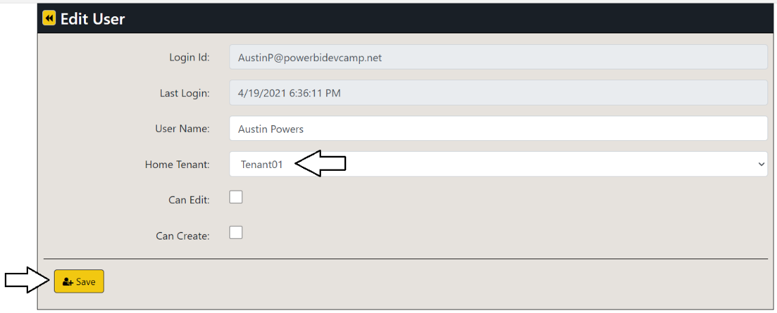
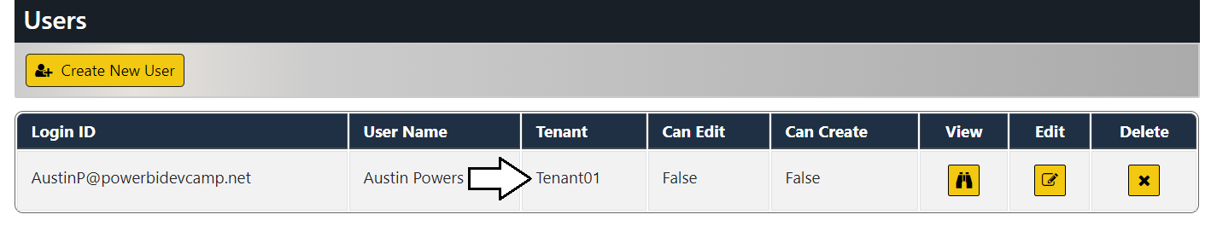
Testing User Permission Assignments
Use AppOwnsDataAdmin to move AppOwnsDataReactClient user through 4 possible states
Test AppOwnsDataReactClient when user is unassigned
Test AppOwnsDataReactClient when user is assigned to tenant with read-only permissions
Test AppOwnsDataReactClient when user is assigned to tenant with edit permissions
Test AppOwnsDataReactClient when user is assigned to tenant with edit + create permissions

Slide 37
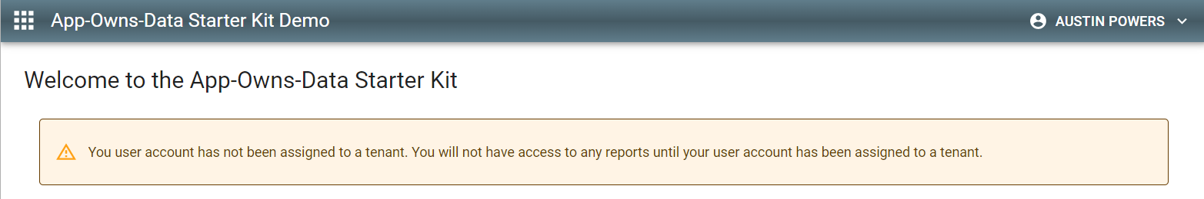
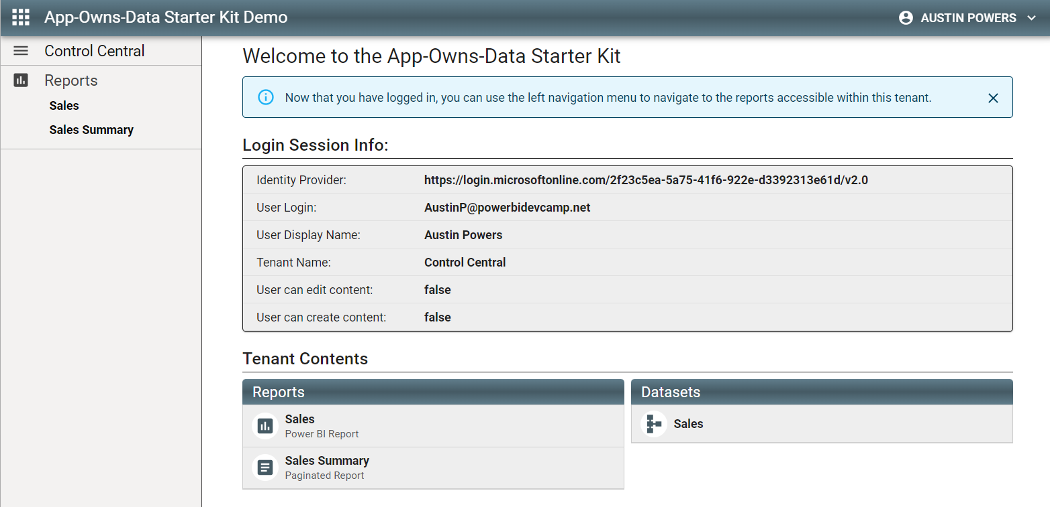
AppOwnsDataReactClient User Experience
Test user experience when user is unassigned
Test experience once user has been assigned to customer tenant

Slide 38
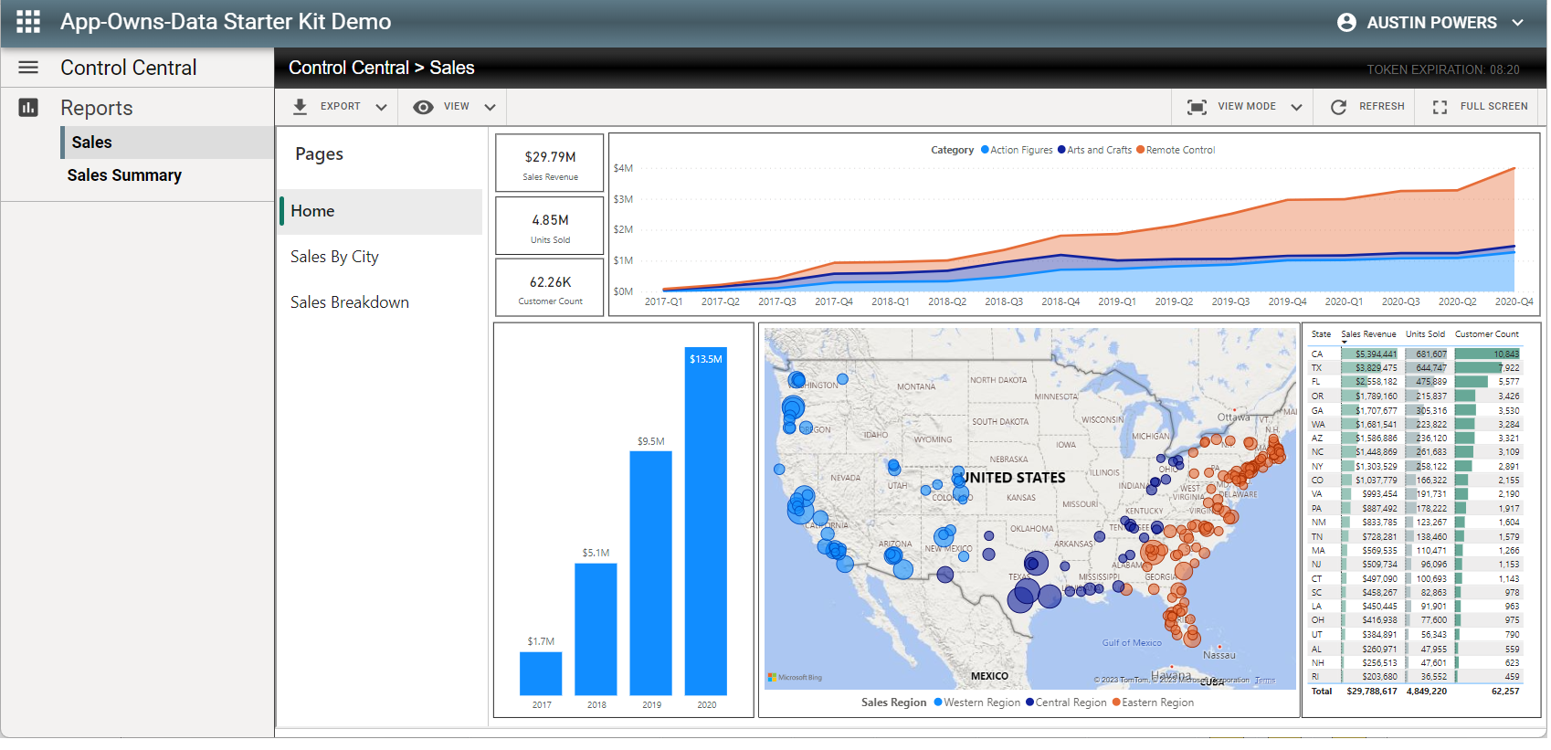
Viewing and Interacting with Reports in Read-only Mode

Slide 39
Agenda
User-Owns-Data versus App-Owns-Data
Authenticating Users with App-Owns-Data
Multi-tenant Provisioning Patterns
Permissions Management with App-Owns-Data
Self-service report authoring
Token Management
Effective Identity and RLS
Monitor user activity

Slide 40
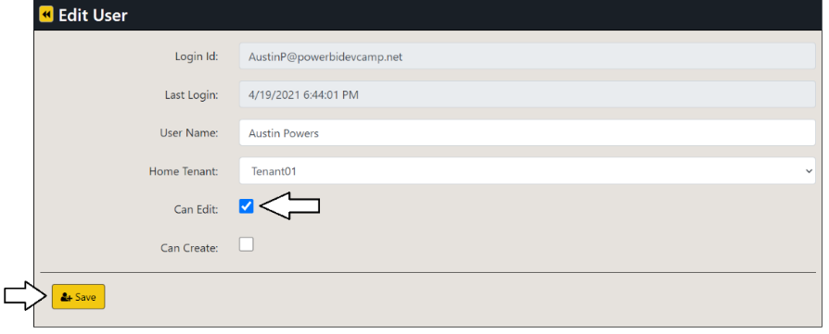
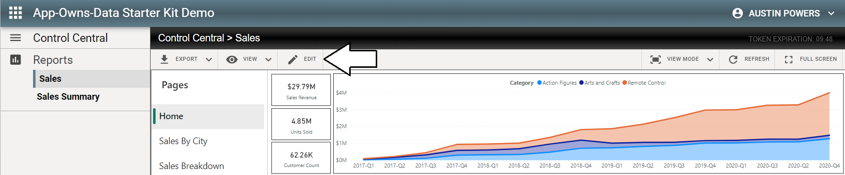
Edit reports using AppOwnsDataReactClient
Test user experience when user has edit permissions
User can move report into edit mode
Once in edit mode, you can customize report and save changes

Slide 41
Agenda
User-Owns-Data versus App-Owns-Data
Authenticating Users with App-Owns-Data
Multi-tenant Provisioning Patterns
Permissions Management with App-Owns-Data
Self-service report authoring
Token Management
Effective Identity and RLS
Monitor user activity

Slide 42
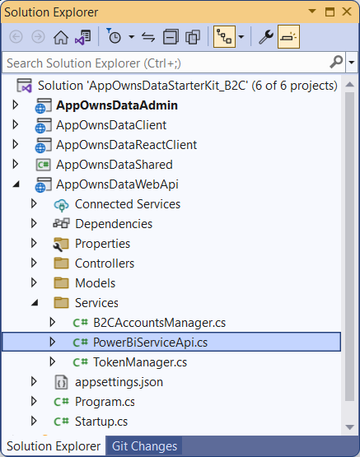
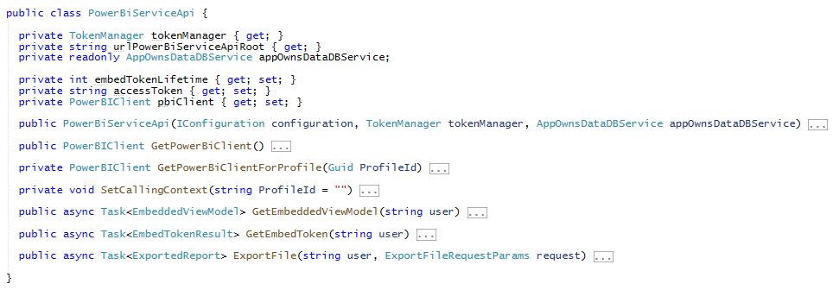
Looking into the C# Code in AppOwnsDataWebApi
Key points to observe in this Web API implementation
It uses Power BI .NET SDK to retrieve embedding data sent to browser in view model
It uses Power BI .NET SDK to generate embed token sent to browser
It uses service principal profiles to access Power BI content in tenant workspaces

Slide 43
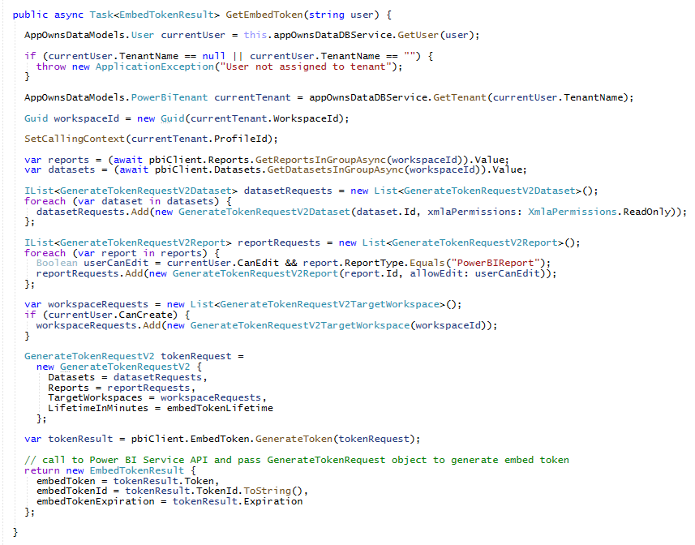
Generating Embed Tokens

Slide 44
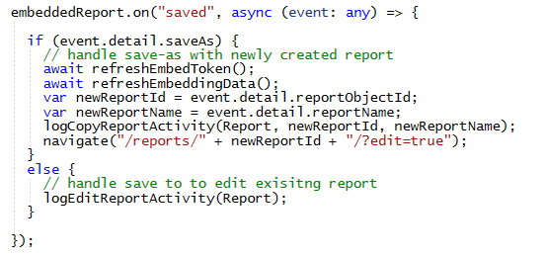
Refreshing EmbedToken and EmbeddingData
Creating new report invalidates embed token and embedding data
EmbedToken does not contain report ID for new report
EmbeddingData does not contain new report in Reports collection
What happens when new report is created with Save As command?
Call to refreshEmbedToken
Call to refreshEmbeddingata
Log CopyReport activity event
Navigate to URL with ID of new report

Slide 45
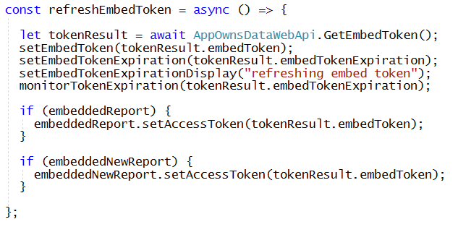
refreshEmbedToken in Report.tsx
refreshEmbedToken calls AppOwnsDataWebApi to get new embed token
Called to prevent embed token from expiring
Called whenever a new report Is created

Slide 46
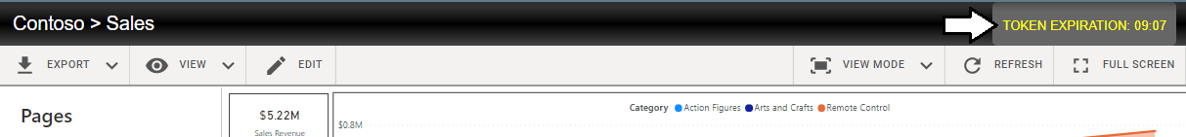
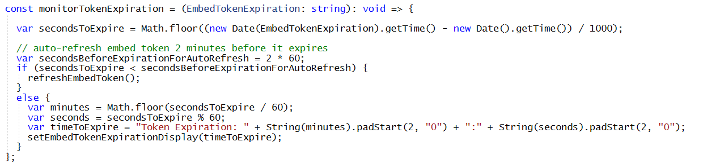
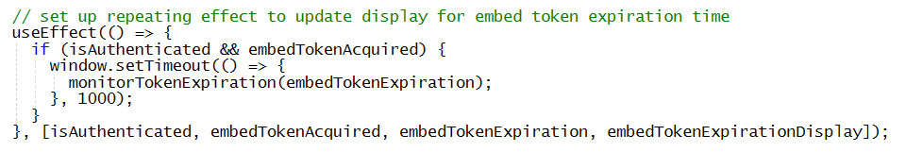
Embed Token Auto-refresh Strategy
Token expiration time displayed to user with ReportPath.tsx
monitorTokenExpiration calls refreshEmbedToken if expiration is two minutes away or less
useEffect function calls setTimeout to periodically call monitorTokenExpiration once a minute

Slide 47
Agenda
User-Owns-Data versus App-Owns-Data
Authenticating Users with App-Owns-Data
Multi-tenant Provisioning Patterns
Permissions Management with App-Owns-Data
Self-service report authoring
Token Management
Effective Identity and RLS
Monitor user activity

Slide 48
Using RLS in Multi-tenant Application Design
Use of RLS is often optional in multitenant applications
Splitting customer data out into separate datasets provides first level of isolation
RLS can be added so users in same customer tenant varying permissions levels

Slide 49
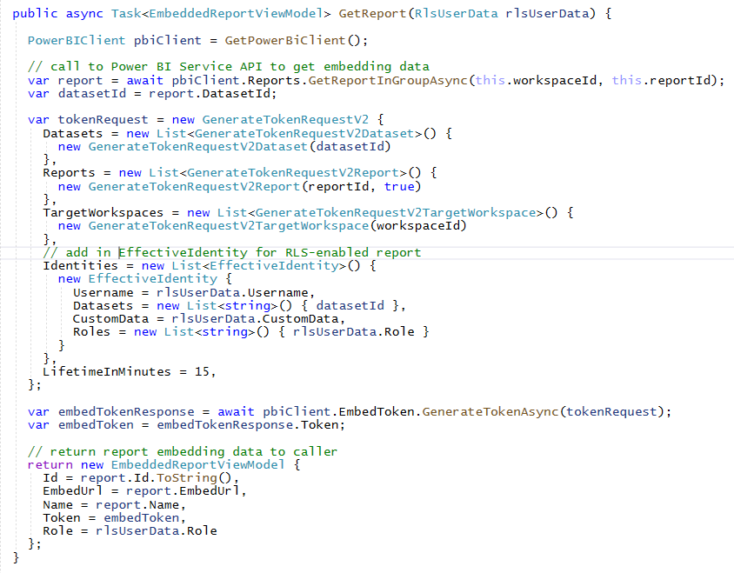
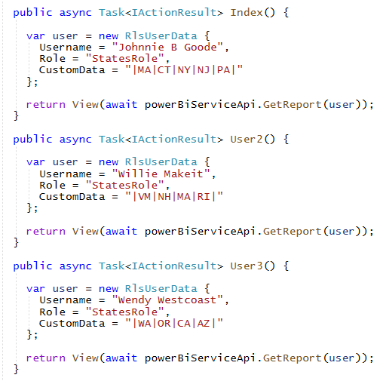
Programming with EffectiveIdentity

Slide 50
Limit Rules with Text Search to Minimal Number of Rows
Beware of performance issues when using expensive RLS rules over large rowsets
50 rows
375,000 rows
5,000,000 rows

Slide 51
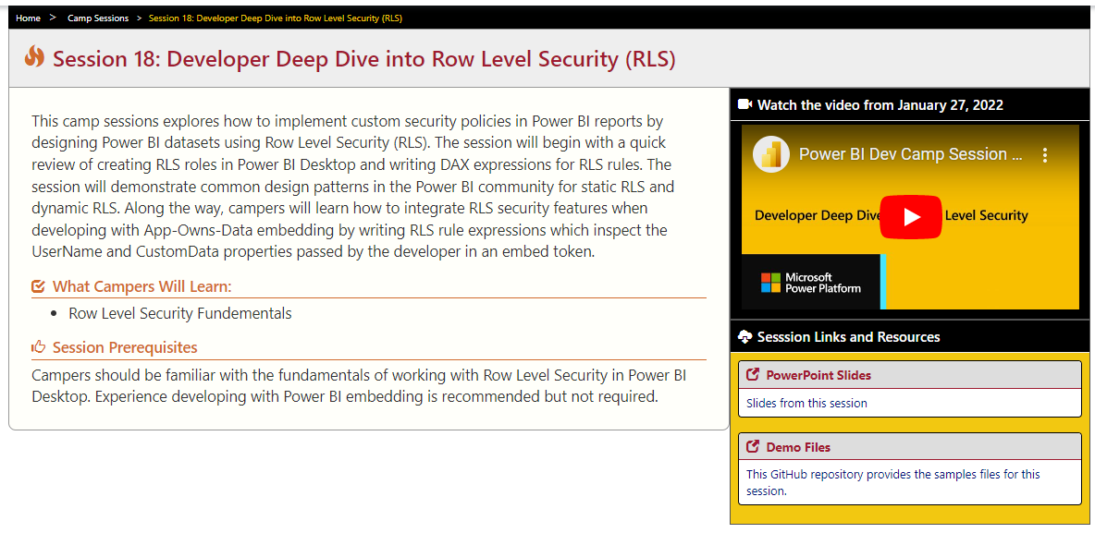
Developer Deep Dive into Row Level Security (RLS)
Session 18: Developer Deep Dive into Row Level Security (RLS)
https://www.powerbidevcamp.net/sessions/session18/

Slide 52
Agenda
User-Owns-Data versus App-Owns-Data
Authenticating Users with App-Owns-Data
Multi-tenant Provisioning Patterns
Permissions Management with App-Owns-Data
Self-service report authoring
Token Management
Effective Identity and RLS
Monitor user activity

Slide 53
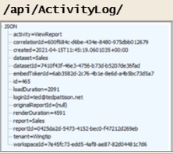
Adding a custom telemetry layer
App-Owns-Data Starter Kit demonstrates adding custom telemetry
AppOwnsDataWebApi exposes ActivityLog endpoint
AppOwnsDataClient logs custom events by posting to ActivityLog endpoint
AppOwnsDataWebApi records event activity in AppOwnsDataDB
AppOwnsDataClient
AppOwnsDataWebApi
AppOwnsDataDB

Slide 54
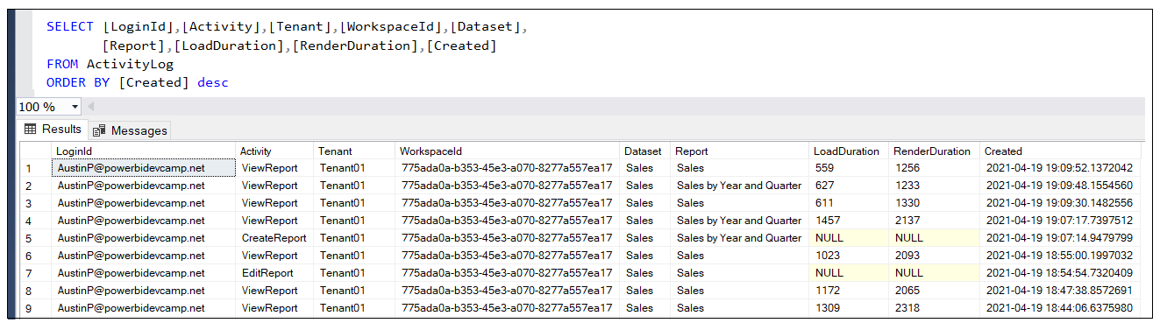
Monitor user activity data from ActivityLog table
AppOwnsDataClient constantly logs user activity
Activity is logged whenever a user views a report
Activity is logged whenever a user edits, copies or creates a report
Activity is logged by AppOwnsDataWebApi by adding record into ActivityLog table

Slide 55
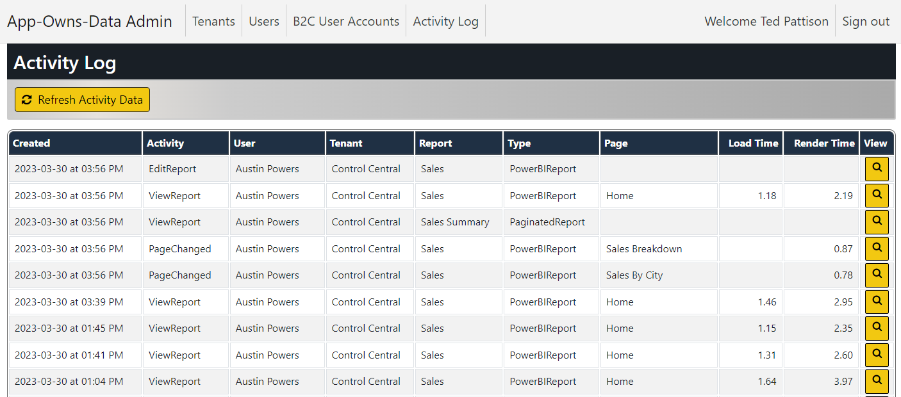
App-Owns-Data Activity Log View

Slide 56
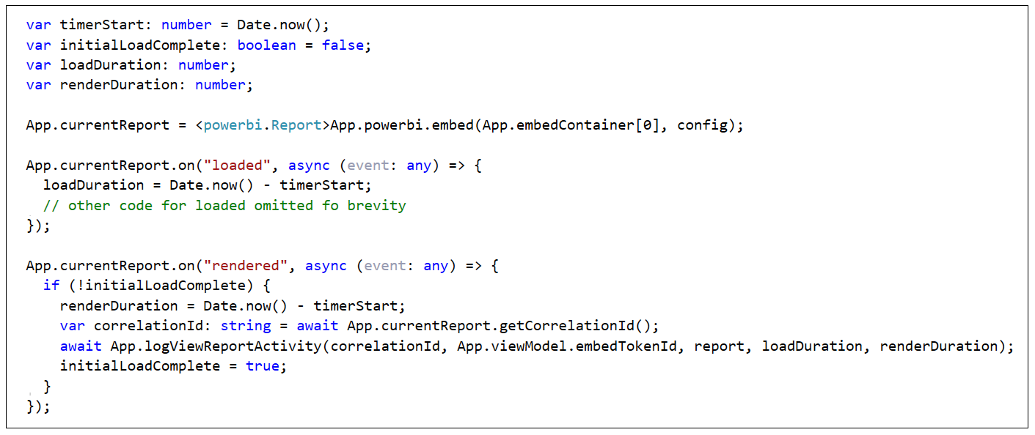
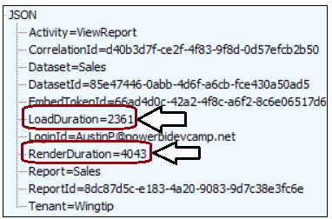
Capturing Report Performance Data
Steps to capture performance data when embedding a report
Capture time before starting the embedding process
Determine time duration between start of embedding and the loaded event
Determine time duration between start of embedding and the rendered event
LoadDuration and RenderDuration recorded in milliseconds
Activity Event Payload

Slide 57
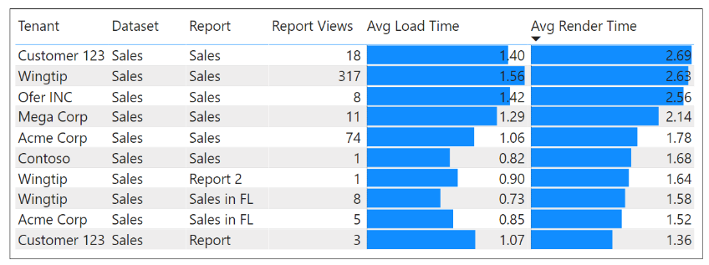
Monitoring Report Performance
ViewReport activity logged with perf data for LoadDuration and RenderDuration
Allows for monitoring/analysis of report performance across multi-tenant environment
Allows for early detection of performance problems affecting user experience

Slide 58
Summary
What we covered today
User-Owns-Data versus App-Owns-Data
Authenticating Users with App-Owns-Data
Multi-tenant Provisioning Patterns
Permissions Management with App-Owns-Data
Self-service report authoring
Token Management
Effective Identity and RLS
Monitor user activity
What’s coming up next month in the April 2023 session?
Setting Datasource Credentials using the Power BI REST API

